Slide 1
SEMESTER 2 WEEK 5
INFERENCES COMPARING
TWO POPULATIONS
MEANS
(t-test)

Slide 2
Lecture outline
Parametric tests
“z-test” versus “t-test”
Two sample t-test: Independent samples
Equal variance
Unequal variance
4. Paired t-test: Dependent samples

Slide 3
Parametric tests
One sample z-test
One Sample
One sample t-test
Parametric Test
Two sample z-test
Independent Samples
Two Samples
Two sample t-test
Paired Samples
Paired t-test

Slide 4
“z-test” vs “t-test”
Yes
No
Is n large (n≥30)?
Yes
Is σ known?
No
Yes
Is the population approximately normal?
No
Yes
Is σ known?
No
Use z-test
Use z-test: replace σ with s
Use t-test:
replace σ with s
Use non-parametric test

Slide 5
t and standard normal distributions

Slide 6
Types of two-sample t-tests
Independent two-sample t-test
Paired t-test
Equal Variance
Unequal Variance
R-code:
t.test(x, y = NULL,
alternative = c("two.sided", "less", "greater"),
mu = 0, paired = FALSE, var.equal = FALSE,
conf.level = 0.95, ...)

Slide 7
Independent Samples: Equal Variance
Equal Variance

Slide 8

Exercise 1: EQUAL VARIANCE
Suppose you wish to compare a new method of teaching reading to “slow learners” with the current standard method. You decide to base your comparison on the results of a reading test given at the end of a learning period of six months. Of a random sample of 22 “slow learners,” 10 are taught by the new method and 12 are taught by the standard method. All 22 children are taught by qualified instructors under similar conditions for the designated six-month period. The test results are given below (assume variances are equal for two populations).
State hypotheses whether new method yields significantly higher test results.
Run the appropriate test using R. Use ⍺ = 0.05.
Provide your decision and conclusion.
New Method | 80 | 80 | 79 | 81 | 76 | 66 | 71 | 76 | 70 | 85
Standard Method | 79 | 62 | 70 | 68 | 73 | 76 | 86 | 73 | 72 | 68 | 75 | 66

Slide 9
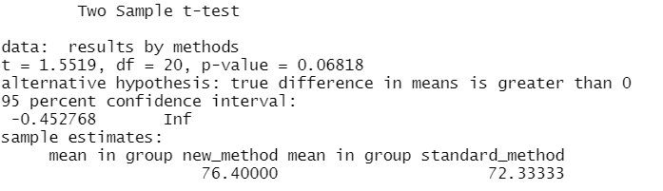
Example 1: SOLUTIONS
State the null and alternative hypotheses.
H₀: µ_{N} - µ_{S} = 0 μ_{N} – new method, μ_{S} – standard method
Ha: µ_{N} - µ_{S} > 0
b. Run the appropriate test using equal variance assumption. Use α = 0.05.
[PLEASE REFER TO R FOR SOLUTIONS]
c. Provide your decision and conclusions.
Since p-value = 0.06818 > ⍺ = 0.05 or t_{stat} = 1.55 < t⍺ = 1.72 we fail to reject H₀ and conclude new teaching method is not significantly better than standard method.

Slide 10
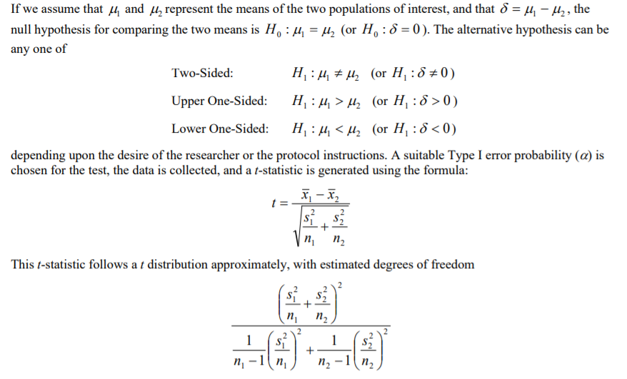
Independent Samples: Unequal Variance

Slide 11
Exercise 2: UNEQUAL VARIANCE
Suppose you wish to compare a new method of teaching reading to “slow learners” with the current standard method. You decide to base your comparison on the results of a reading test given at the end of a learning period of six months. Of a random sample of 22 “slow learners,” 10 are taught by the new method and 12 are taught by the standard method. All 22 children are taught by qualified instructors under similar conditions for the designated six-month period. The test results are given below (assume variances are unequal for two populations).
State hypotheses whether new method yields significantly higher test results.
Run the appropriate test using R. Use ⍺ = 0.05.
Provide your decision and conclusion.
New Method | 80 | 80 | 79 | 81 | 76 | 66 | 71 | 76 | 70 | 85
Standard Method | 79 | 62 | 70 | 68 | 73 | 76 | 86 | 73 | 72 | 68 | 75 | 66

Slide 12
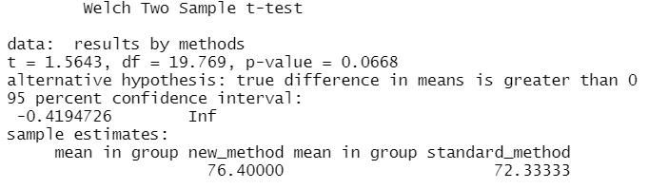
Example 2: SOLUTIONS
State the null and alternative hypotheses.
H₀: µ_{N} - µ_{S} = 0 μ_{N} – new method, μ_{S} – standard method
Ha: µ_{N} - µ_{S} > 0
b. Run the appropriate test using equal variance assumption. Use α = 0.05.
[PLEASE REFER TO R FOR SOLUTIONS]
c. Provide your decision and conclusions.
Since p-value = 0.0668 > ⍺ = 0.05 or t_{stat} = 1.5643 < t⍺ = 1.72 we fail to reject H₀ and conclude new teaching method is not significantly better than standard method.

Slide 13
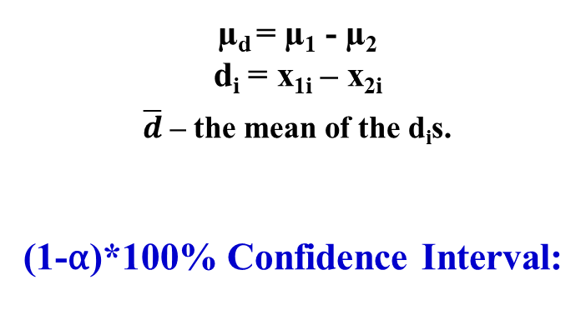
INFERENCES ABOUT µ₁ - µ₂: PAIRED DATA
CONDITIONS:
1. The sampling distribution of the pairwise differences is a normal distribution.
2. The pairs of observations are independent.
Hypothesis Testing:
µ_{d} = µ₁ - µ₂
d_{i} = x_{1i} – x_{2i}
$\overline{d}$ – the mean of the d_{i}s.
(1-⍺)*100% Confidence Interval:

Slide 14

Exercise 3: PAIRED DATA
An experiment is conducted to compare the starting salaries of male and female college graduates who find jobs. Pairs are formed by choosing a male and a female with the same major and similar grade point averages (GPAs). Suppose a random sample of 10 pairs is formed in this manner and the starting annual salary of each person is recorded (Data is given below).
State hypotheses to see whether there is gender difference in salaries.
Run the appropriate test using R. Use ⍺ = 0.10.
Provide your decision and conclusion.
Pair | 1 | 2 | 3 | 4 | 5 | 6 | 7 | 8 | 9 | 10
Male | $29,300 | $41,500 | $40,400 | $38,500 | $43,500 | $37,800 | $69,500 | $41,200 | $38,400 | $59,200
Female | $28,800 | $41,600 | $39,800 | $38,500 | $42,600 | $38,000 | $69,200 | $40,100 | $38,200 | $58,500

Slide 15
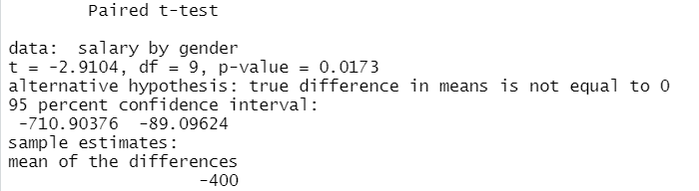
Exercise 3: SOLUTIONS
This is paired, because they are matched on GPA and major, which means there is some dependence on qualifications.
State hypotheses to see whether there is gender difference in salaries.
H₀: μ_{D} = 0 NOTE: μ_{D} = μ_{Male} – μ_{Female}
Ha: μ_{D} ≠ 0 ➔ This is two tailed test.
b. Run the appropriate test using R. Use ⍺ = 0.10.
[Please, refer to R for solutions]
c. Provide your decision and conclusion.
Since |t_{stat}| = 2.91 > t_{⍺/2} = 1.83 or p-value = 0.017 < ⍺ = 0.10 we reject H₀ and conclude that females are paid significantly lower than males.

Slide 16
AND NOW . . .
TIME TO PRACTICE!

